Slide 1
Mob, mot, mov

Slide 2
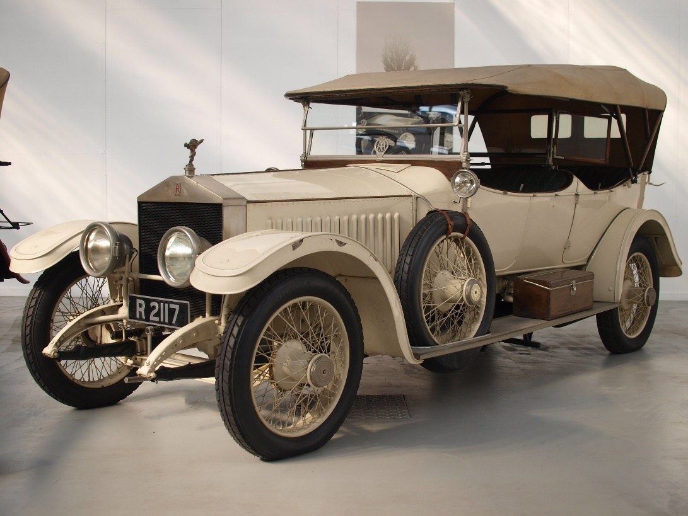
automoblie (n)
A self propelled passenger vehicle that moves
This Photo by Unknown Author is licensed under CC BY-SA

Slide 3
demote (v)
to move down in grade, rank, or status
This Photo by Unknown Author is licensed under CC BY-SA

Slide 4
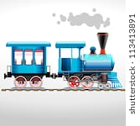
locomotion (n)
Ability to move from place to place

Slide 5
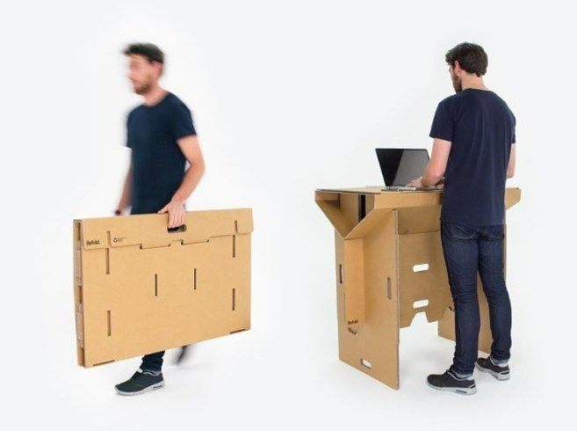
mobile (adj.) mobility (n)
Capable of moving or being moved; quality of being
able to move

Slide 6
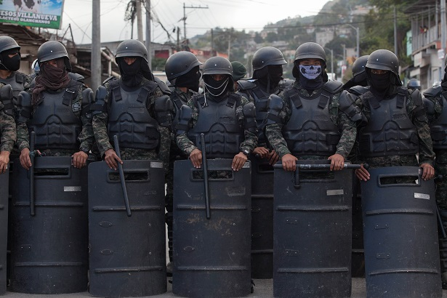
mobilize (v)
O move people or things around for a purpose
This Photo by Unknown Author is licensed under CC BY-SA-NC

Slide 7
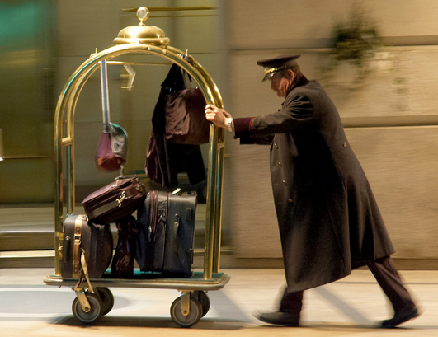
motion (n)
The act or process of changing place or
position; the
ability or
power to
move

Slide 8
motivate (v)
To cause a person to move into action
This Photo by Unknown Author is licensed under CC BY-SA

Slide 9
Promote (v)
to raise or move to a higher grade, rank, or job; to advocate
This Photo by Unknown Author is licensed under CC BY-NC-ND

Slide 10
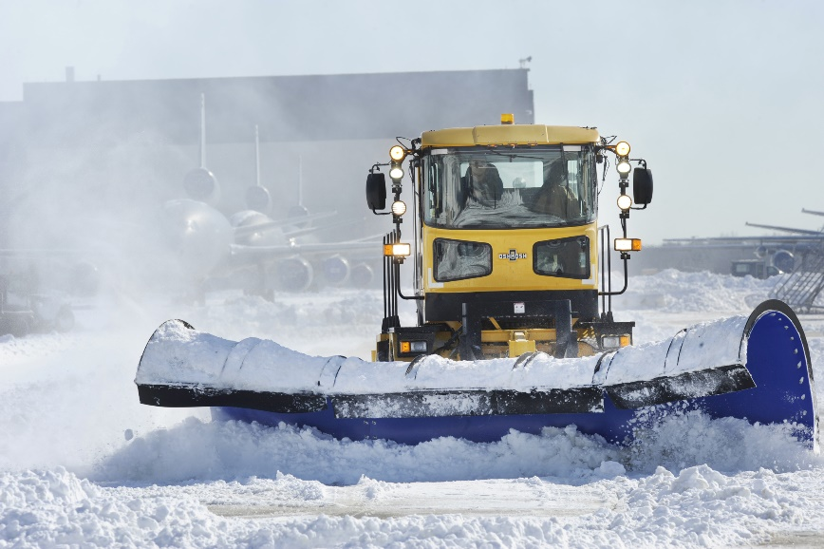
removal (v)
To move something away
This Photo by Unknown Author is licensed under CC BY-SA

Slide 11
Mov, mot, mob
Turn and talk: what is the meaning of this root?
This Photo by Unknown Author is licensed under CC BY-NC-ND

